Slide 1
Seq2seq Workshop
NLP Basics
Jorge Balazs Suzana Ilic Asir Saeed
2019 - 03 - 16

Slide 2
A few words about me
My name is Jorge /xoɾxe/ (George /dʒɔː(ɹ)dʒ/)
3rd Year PhD Student
Broad Interests: Natural language Processing, Deep Learning, Software Development
Fine-grained Interests: Representation Learning, Subword Representations
Background (Undergrad): Industrial Engineering (Business)
@jabalazst
balazs.jorge@gmail.com

Slide 3
Outline
The NLP Pipeline
Preprocessing: Strings to vectors
Word Embeddings

Slide 4
The NLP pipeline

Slide 5
The NLP pipeline
Computer
NLP System
Proxy of meaning
Text
Voice

Slide 6
The NLP pipeline
NLP System
Preprocessing
Lexical Analysis
Syntactic Analysis
Semantic Analysis
Task

Slide 7
The NLP pipeline
NLP System
Preprocessing
Lexical Analysis
Syntactic Analysis
Semantic Analysis
Task
Notes:
Most modern Deep Learning approaches will use this (at least as first step)

Slide 8
Preprocessing: Strings to Vectors

Slide 9
Preprocessing
Preprocessing
Tokenization
Tokens to IDs
IDs to vectors
Text
Vectors

Slide 10
Preprocessing
Preprocessing
Tokenization
Tokens to IDs
IDs to vectors
Text
Vectors

Slide 11
Tokenization
Tokenization
Tokens to IDs
IDs to vectors
Text
Vectors

Slide 12
Tokenization
Tokenization
Tokens to IDs
IDs to vectors
Text
Vectors
"the cat sat on the mat."
"the dog sat on the cold floor."
"the rain fell from the sky."

Slide 13
Tokenization
Tokenization
Tokens to IDs
IDs to vectors
Text
Vectors
"the cat sat on the mat."
"the dog sat on the cold floor."
"the rain fell from the sky."
["the", "cat", "sat", "on", "the", "mat", "."]
["the", "dog", "sat", "on" "the", "cold", "floor", "."]
["the", "rain", "fell", "from", "the", "sky", "."]

Slide 14
Tokenization
Tokenization
Tokens to IDs
IDs to vectors
Text
Vectors
"the cat sat on the mat."
"the dog sat on the cold floor."
"the rain fell from the sky."
["the", "cat", "sat", "on", "the", "mat", "."]
["the", "dog", "sat", "on" "the", "cold", "floor", "."]
["the", "rain", "fell", "from", "the", "sky", "."]
We need to store the tokens we know somewhere: the vocabulary

Slide 15
Tokens to IDs - Vocabulary
Tokenization
Tokens to IDs
IDs to vectors
Text
Vectors
"the cat sat on the mat."
"the dog sat on the cold floor."
"the rain fell from the sky."
["the", "cat", "sat", "on", "the", "mat", "."]
["the", "dog", "sat", "on" "the", "cold", "floor", "."]
["the", "rain", "fell", "from", "the", "sky", "."]
vocabulary = {'the': 0, 'cat': 1,
'sat: 2, 'on': 3,
'mat': 4,'.': 5,
'dog': 6, 'cold': 7,
'floor': 8, 'rain': 9,
'fell': 10, 'from': 11,
'sky': 12
}
frequencies = {'the': 6, 'cat': 1,
'sat: 2, 'on': 2,
'mat': 1,'.': 3,
'dog': 1, 'cold': 1,
'floor': 1, 'rain': 1,
'fell': 1, 'from': 1,
'sky': 1
}

Slide 16
Tokens to IDs
Tokenization
Tokens to IDs
IDs to vectors
Text
Vectors
["the", "cat", "sat", "on", "the", "mat", "."]
["the", "dog", "sat", "on" "the", "cold", "floor", "."]
["the", "rain", "fell", "from", "the", "sky", "."]
[0, 1, 2, 3, 0, 4, 5]
[0, 6, 2, 3, 0, 7, 8, 5]
[0, 9, 10, 11, 0, 12, 5]
vocabulary = {'the': 0, 'cat': 1,
'sat: 2, 'on': 3,
'mat': 4,'.': 5,
'dog': 6, 'cold': 7,
'floor': 8, 'rain': 9,
'fell': 10, 'from': 11,
'sky': 12
}
frequencies = {'the': 6, 'cat': 1,
'sat: 2, 'on': 2,
'mat': 1,'.': 3,
'dog': 1, 'cold': 1,
'floor': 1, 'rain': 1,
'fell': 1, 'from': 1,
'sky': 1
}

Slide 17
Vocabulary
It's common to do some adjustments to the vocabulary during its creation:
Add special _unk_, _pad_, _bos_ and _eos_ tokens:
_unk_: used for words not seen during training, or words with low frequency
_pad_: special token added to make sequence representations of the same length
_bos_: for marking the "beginning of sentence"
_eos_: for marking the "end of sentence"
Limit its size:
For example, keep the most frequent 50.000 tokens and consider the rest as _unk_.
Filter out words with a frequency lower than a user-specified threshold (e.g., 2), to reduce overfitting.
vocabulary = {'the': 0, 'cat': 1,
'sat: 2, 'on': 3,
'mat': 4,'.': 5,
'dog': 6, 'cold': 7,
'floor': 8, 'rain': 9,
'fell': 10, 'from': 11,
'sky': 12
}

Slide 18
Vocabulary
It's common to do some adjustments to the vocabulary during its creation:
Add special _unk_, _pad_, _bos_ and _eos_ tokens:
_unk_: used for words not seen during training, or words with low frequency
_pad_: special token added to make sequence representations of the same length
_bos_: for marking the "beginning of sentence"
_eos_: for marking the "end of sentence"
Limit its size:
For example, keep the most frequent 50.000 tokens and consider the rest as _unk_.
Filter out words with a frequency lower than a user-specified threshold (e.g., 2), to reduce overfitting.
vocabulary = {'the': 0, 'cat': 1,
'sat: 2, 'on': 3,
'mat': 4,'.': 5,
'dog': 6, 'cold': 7,
'floor': 8, 'rain': 9,
'fell': 10, 'from': 11,
'sky': 12, '_unk_': 13,
'_pad_': 14, '_bos_':15,
'_eos_': 16
}
Notes:
For our toy example we will not limit the vocab size nor filter low freq words, you'll see that later in the workshop

Slide 19
IDs to vectors
Tokenization
Tokens to IDs
IDs to Vectors
Text
Vectors
["the", "cat", "sat", "on", "the", "mat", "."]
["the", "dog", "sat", "on" "the", "cold", "floor", "."]
["the", "rain", "fell", "from", "the", "sky", "."]
[0, 1, 2, 3, 0, 4, 5]
[0, 6, 2, 3, 0, 7, 8, 5]
[0, 9, 10, 11, 0, 12, 5]
vocabulary = {'the': 0, 'cat': 1,
'sat: 2, 'on': 3,
'mat': 4,'.': 5,
'dog': 6, 'cold': 7,
'floor': 8, 'rain': 9,
'fell': 10, 'from': 11,
'sky': 12
}
frequencies = {'the': 6, 'cat': 1,
'sat: 2, 'on': 2,
'mat': 1,'.': 3,
'dog': 1, 'cold': 1,
'floor': 1, 'rain': 1,
'fell': 1, 'from': 1,
'sky': 1
}

Slide 20
Vocabulary
Tokenization
Tokens to IDs
IDs to Vectors
Text
Vectors
Now we need a vector representation for each token. The simplest one is a one-hot encoding (Although most of what I'm about to say applies to embeddings as well):
the
0
1
0
0
0
0
0
0
0
0
0
0
0
0
vocabulary = {'the': 0, 'cat': 1,
'sat: 2, 'on': 3,
'mat': 4,'.': 5,
'dog': 6, 'cold': 7,
'floor': 8, 'rain': 9,
'fell': 10, 'from': 11,
'sky': 12
}
cat
1
0
1
0
0
0
0
0
0
0
0
0
0
0
sat
2
0
0
1
0
0
0
0
0
0
0
0
0
0
on
3
0
0
0
1
0
0
0
0
0
0
0
0
0
mat
4
0
0
0
0
1
0
0
0
0
0
0
0
0
.
5
0
0
0
0
0
1
0
0
0
0
0
0
0
dog
6
0
0
0
0
0
0
1
0
0
0
0
0
0
cold
7
0
0
0
0
0
0
0
1
0
0
0
0
0
floor
8
0
0
0
0
0
0
0
0
1
0
0
0
0
Transforming words into vectors boils down to selecting the i-th row (column) of this matrix, where i is the ID of the word
rain
9
0
0
0
0
0
0
0
0
0
1
0
0
0
fell
10
0
0
0
0
0
0
0
0
0
0
1
0
0
from
11
0
0
0
0
0
0
0
0
0
0
0
1
0
sky
12
0
0
0
0
0
0
0
0
0
0
0
0
1

Slide 21
IDs to Vectors
Tokenization
Tokens to IDs
IDs to Vectors
Text
Vectors
["the", "dog", "sat", "on" "the", "cold", "floor", "."]
[0, 6, 2, 3, 0, 7, 8, 5]
the
0
1
0
0
0
0
0
0
0
0
0
0
0
0
cat
1
0
1
0
0
0
0
0
0
0
0
0
0
0
sat
2
0
0
1
0
0
0
0
0
0
0
0
0
0
on
3
0
0
0
1
0
0
0
0
0
0
0
0
0
mat
4
0
0
0
0
1
0
0
0
0
0
0
0
0
.
5
0
0
0
0
0
1
0
0
0
0
0
0
0
dog
6
0
0
0
0
0
0
1
0
0
0
0
0
0
cold
7
0
0
0
0
0
0
0
1
0
0
0
0
0
floor
8
0
0
0
0
0
0
0
0
1
0
0
0
0
rain
9
0
0
0
0
0
0
0
0
0
1
0
0
0
fell
10
0
0
0
0
0
0
0
0
0
0
1
0
0
from
11
0
0
0
0
0
0
0
0
0
0
0
1
0
sky
12
0
0
0
0
0
0
0
0
0
0
0
0
1

Slide 22
IDs to Vectors
Tokenization
Tokens to IDs
IDs to Vectors
Text
Vectors
["the", "dog", "sat", "on" "the", "cold", "floor", "."]
[0, 6, 2, 3, 0, 7, 8, 5]
the
0
1
0
0
0
0
0
0
0
0
0
0
0
0
the
0
1
0
0
0
0
0
0
0
0
0
0
0
0
cat
1
0
1
0
0
0
0
0
0
0
0
0
0
0
sat
2
0
0
1
0
0
0
0
0
0
0
0
0
0
on
3
0
0
0
1
0
0
0
0
0
0
0
0
0
mat
4
0
0
0
0
1
0
0
0
0
0
0
0
0
.
5
0
0
0
0
0
1
0
0
0
0
0
0
0
dog
6
0
0
0
0
0
0
1
0
0
0
0
0
0
cold
7
0
0
0
0
0
0
0
1
0
0
0
0
0
floor
8
0
0
0
0
0
0
0
0
1
0
0
0
0
rain
9
0
0
0
0
0
0
0
0
0
1
0
0
0
fell
10
0
0
0
0
0
0
0
0
0
0
1
0
0
from
11
0
0
0
0
0
0
0
0
0
0
0
1
0
sky
12
0
0
0
0
0
0
0
0
0
0
0
0
1

Slide 23
IDs to Vectors
Tokenization
Tokens to IDs
IDs to Vectors
Text
Vectors
["the", "dog", "sat", "on" "the", "cold", "floor", "."]
[0, 6, 2, 3, 0, 7, 8, 5]
the
0
1
0
0
0
0
0
0
0
0
0
0
0
0
the
0
1
0
0
0
0
0
0
0
0
0
0
0
0
cat
1
0
1
0
0
0
0
0
0
0
0
0
0
0
dog
6
0
0
0
0
0
0
1
0
0
0
0
0
0
sat
2
0
0
1
0
0
0
0
0
0
0
0
0
0
on
3
0
0
0
1
0
0
0
0
0
0
0
0
0
mat
4
0
0
0
0
1
0
0
0
0
0
0
0
0
.
5
0
0
0
0
0
1
0
0
0
0
0
0
0
dog
6
0
0
0
0
0
0
1
0
0
0
0
0
0
cold
7
0
0
0
0
0
0
0
1
0
0
0
0
0
floor
8
0
0
0
0
0
0
0
0
1
0
0
0
0
rain
9
0
0
0
0
0
0
0
0
0
1
0
0
0
fell
10
0
0
0
0
0
0
0
0
0
0
1
0
0
from
11
0
0
0
0
0
0
0
0
0
0
0
1
0
sky
12
0
0
0
0
0
0
0
0
0
0
0
0
1

Slide 24
IDs to Vectors
Tokenization
Tokens to IDs
IDs to Vectors
Text
Vectors
["the", "dog", "sat", "on" "the", "cold", "floor", "."]
[0, 6, 2, 3, 0, 7, 8, 5]
the
0
1
0
0
0
0
0
0
0
0
0
0
0
0
the
0
1
0
0
0
0
0
0
0
0
0
0
0
0
cat
1
0
1
0
0
0
0
0
0
0
0
0
0
0
dog
6
0
0
0
0
0
0
1
0
0
0
0
0
0
sat
2
0
0
1
0
0
0
0
0
0
0
0
0
0
sat
2
0
0
1
0
0
0
0
0
0
0
0
0
0
on
3
0
0
0
1
0
0
0
0
0
0
0
0
0
mat
4
0
0
0
0
1
0
0
0
0
0
0
0
0
.
5
0
0
0
0
0
1
0
0
0
0
0
0
0
dog
6
0
0
0
0
0
0
1
0
0
0
0
0
0
cold
7
0
0
0
0
0
0
0
1
0
0
0
0
0
floor
8
0
0
0
0
0
0
0
0
1
0
0
0
0
rain
9
0
0
0
0
0
0
0
0
0
1
0
0
0
fell
10
0
0
0
0
0
0
0
0
0
0
1
0
0
from
11
0
0
0
0
0
0
0
0
0
0
0
1
0
sky
12
0
0
0
0
0
0
0
0
0
0
0
0
1

Slide 25
IDs to Vectors
Tokenization
Tokens to IDs
IDs to Vectors
Text
Vectors
["the", "dog", "sat", "on" "the", "cold", "floor", "."]
[0, 6, 2, 3, 0, 7, 8, 5]
the
0
1
0
0
0
0
0
0
0
0
0
0
0
0
the
0
1
0
0
0
0
0
0
0
0
0
0
0
0
cat
1
0
1
0
0
0
0
0
0
0
0
0
0
0
dog
6
0
0
0
0
0
0
1
0
0
0
0
0
0
sat
2
0
0
1
0
0
0
0
0
0
0
0
0
0
sat
2
0
0
1
0
0
0
0
0
0
0
0
0
0
on
3
0
0
0
1
0
0
0
0
0
0
0
0
0
on
3
0
0
0
1
0
0
0
0
0
0
0
0
0
mat
4
0
0
0
0
1
0
0
0
0
0
0
0
0
.
5
0
0
0
0
0
1
0
0
0
0
0
0
0
dog
6
0
0
0
0
0
0
1
0
0
0
0
0
0
cold
7
0
0
0
0
0
0
0
1
0
0
0
0
0
floor
8
0
0
0
0
0
0
0
0
1
0
0
0
0
rain
9
0
0
0
0
0
0
0
0
0
1
0
0
0
fell
10
0
0
0
0
0
0
0
0
0
0
1
0
0
from
11
0
0
0
0
0
0
0
0
0
0
0
1
0
sky
12
0
0
0
0
0
0
0
0
0
0
0
0
1

Slide 26
IDs to Vectors
Tokenization
Tokens to IDs
IDs to Vectors
Text
Vectors
["the", "dog", "sat", "on" "the", "cold", "floor", "."]
[0, 6, 2, 3, 0, 7, 8, 5]
the
0
1
0
0
0
0
0
0
0
0
0
0
0
0
the
0
1
0
0
0
0
0
0
0
0
0
0
0
0
cat
1
0
1
0
0
0
0
0
0
0
0
0
0
0
dog
6
0
0
0
0
0
0
1
0
0
0
0
0
0
sat
2
0
0
1
0
0
0
0
0
0
0
0
0
0
sat
2
0
0
1
0
0
0
0
0
0
0
0
0
0
on
3
0
0
0
1
0
0
0
0
0
0
0
0
0
on
3
0
0
0
1
0
0
0
0
0
0
0
0
0
mat
4
0
0
0
0
1
0
0
0
0
0
0
0
0
the
0
1
0
0
0
0
0
0
0
0
0
0
0
0
.
5
0
0
0
0
0
1
0
0
0
0
0
0
0
dog
6
0
0
0
0
0
0
1
0
0
0
0
0
0
cold
7
0
0
0
0
0
0
0
1
0
0
0
0
0
floor
8
0
0
0
0
0
0
0
0
1
0
0
0
0
rain
9
0
0
0
0
0
0
0
0
0
1
0
0
0
fell
10
0
0
0
0
0
0
0
0
0
0
1
0
0
from
11
0
0
0
0
0
0
0
0
0
0
0
1
0
sky
12
0
0
0
0
0
0
0
0
0
0
0
0
1

Slide 27
IDs to Vectors
Tokenization
Tokens to IDs
IDs to Vectors
Text
Vectors
["the", "dog", "sat", "on" "the", "cold", "floor", "."]
[0, 6, 2, 3, 0, 7, 8, 5]
the
0
1
0
0
0
0
0
0
0
0
0
0
0
0
the
0
1
0
0
0
0
0
0
0
0
0
0
0
0
cat
1
0
1
0
0
0
0
0
0
0
0
0
0
0
dog
6
0
0
0
0
0
0
1
0
0
0
0
0
0
sat
2
0
0
1
0
0
0
0
0
0
0
0
0
0
sat
2
0
0
1
0
0
0
0
0
0
0
0
0
0
on
3
0
0
0
1
0
0
0
0
0
0
0
0
0
on
3
0
0
0
1
0
0
0
0
0
0
0
0
0
mat
4
0
0
0
0
1
0
0
0
0
0
0
0
0
the
0
1
0
0
0
0
0
0
0
0
0
0
0
0
.
5
0
0
0
0
0
1
0
0
0
0
0
0
0
cold
7
0
0
0
0
0
0
0
1
0
0
0
0
0
dog
6
0
0
0
0
0
0
1
0
0
0
0
0
0
cold
7
0
0
0
0
0
0
0
1
0
0
0
0
0
floor
8
0
0
0
0
0
0
0
0
1
0
0
0
0
rain
9
0
0
0
0
0
0
0
0
0
1
0
0
0
fell
10
0
0
0
0
0
0
0
0
0
0
1
0
0
from
11
0
0
0
0
0
0
0
0
0
0
0
1
0
sky
12
0
0
0
0
0
0
0
0
0
0
0
0
1

Slide 28
IDs to Vectors
Tokenization
Tokens to IDs
IDs to Vectors
Text
Vectors
["the", "dog", "sat", "on" "the", "cold", "floor", "."]
[0, 6, 2, 3, 0, 7, 8, 5]
the
0
1
0
0
0
0
0
0
0
0
0
0
0
0
the
0
1
0
0
0
0
0
0
0
0
0
0
0
0
cat
1
0
1
0
0
0
0
0
0
0
0
0
0
0
dog
6
0
0
0
0
0
0
1
0
0
0
0
0
0
sat
2
0
0
1
0
0
0
0
0
0
0
0
0
0
sat
2
0
0
1
0
0
0
0
0
0
0
0
0
0
on
3
0
0
0
1
0
0
0
0
0
0
0
0
0
on
3
0
0
0
1
0
0
0
0
0
0
0
0
0
mat
4
0
0
0
0
1
0
0
0
0
0
0
0
0
the
0
1
0
0
0
0
0
0
0
0
0
0
0
0
.
5
0
0
0
0
0
1
0
0
0
0
0
0
0
cold
7
0
0
0
0
0
0
0
1
0
0
0
0
0
dog
6
0
0
0
0
0
0
1
0
0
0
0
0
0
floor
8
0
0
0
0
0
0
0
0
1
0
0
0
0
cold
7
0
0
0
0
0
0
0
1
0
0
0
0
0
floor
8
0
0
0
0
0
0
0
0
1
0
0
0
0
rain
9
0
0
0
0
0
0
0
0
0
1
0
0
0
fell
10
0
0
0
0
0
0
0
0
0
0
1
0
0
from
11
0
0
0
0
0
0
0
0
0
0
0
1
0
sky
12
0
0
0
0
0
0
0
0
0
0
0
0
1

Slide 29
IDs to Vectors
Tokenization
Tokens to IDs
IDs to Vectors
Text
Vectors
["the", "dog", "sat", "on" "the", "cold", "floor", "."]
[0, 6, 2, 3, 0, 7, 8, 5]
the
0
1
0
0
0
0
0
0
0
0
0
0
0
0
the
0
1
0
0
0
0
0
0
0
0
0
0
0
0
cat
1
0
1
0
0
0
0
0
0
0
0
0
0
0
dog
6
0
0
0
0
0
0
1
0
0
0
0
0
0
sat
2
0
0
1
0
0
0
0
0
0
0
0
0
0
sat
2
0
0
1
0
0
0
0
0
0
0
0
0
0
on
3
0
0
0
1
0
0
0
0
0
0
0
0
0
on
3
0
0
0
1
0
0
0
0
0
0
0
0
0
mat
4
0
0
0
0
1
0
0
0
0
0
0
0
0
the
0
1
0
0
0
0
0
0
0
0
0
0
0
0
.
5
0
0
0
0
0
1
0
0
0
0
0
0
0
cold
7
0
0
0
0
0
0
0
1
0
0
0
0
0
dog
6
0
0
0
0
0
0
1
0
0
0
0
0
0
floor
8
0
0
0
0
0
0
0
0
1
0
0
0
0
cold
7
0
0
0
0
0
0
0
1
0
0
0
0
0
.
5
0
0
0
0
0
1
0
0
0
0
0
0
0
floor
8
0
0
0
0
0
0
0
0
1
0
0
0
0
rain
9
0
0
0
0
0
0
0
0
0
1
0
0
0
fell
10
0
0
0
0
0
0
0
0
0
0
1
0
0
from
11
0
0
0
0
0
0
0
0
0
0
0
1
0
sky
12
0
0
0
0
0
0
0
0
0
0
0
0
1

Slide 30
IDs to Vectors
Tokenization
Tokens to IDs
IDs to Vectors
Text
Vectors
["the", "dog", "sat", "on" "the", "cold", "floor", "."]
[0, 6, 2, 3, 0, 7, 8, 5]
the
0
1
0
0
0
0
0
0
0
0
0
0
0
0
the
0
1
0
0
0
0
0
0
0
0
0
0
0
0
cat
1
0
1
0
0
0
0
0
0
0
0
0
0
0
dog
6
0
0
0
0
0
0
1
0
0
0
0
0
0
sat
2
0
0
1
0
0
0
0
0
0
0
0
0
0
sat
2
0
0
1
0
0
0
0
0
0
0
0
0
0
on
3
0
0
0
1
0
0
0
0
0
0
0
0
0
on
3
0
0
0
1
0
0
0
0
0
0
0
0
0
mat
4
0
0
0
0
1
0
0
0
0
0
0
0
0
the
0
1
0
0
0
0
0
0
0
0
0
0
0
0
.
5
0
0
0
0
0
1
0
0
0
0
0
0
0
cold
7
0
0
0
0
0
0
0
1
0
0
0
0
0
dog
6
0
0
0
0
0
0
1
0
0
0
0
0
0
floor
8
0
0
0
0
0
0
0
0
1
0
0
0
0
cold
7
0
0
0
0
0
0
0
1
0
0
0
0
0
.
5
0
0
0
0
0
1
0
0
0
0
0
0
0
floor
8
0
0
0
0
0
0
0
0
1
0
0
0
0
rain
9
0
0
0
0
0
0
0
0
0
1
0
0
0
The same procedure can be applied to any matrix containing vector representations for tokens (for example, an embedding matrix).
fell
10
0
0
0
0
0
0
0
0
0
0
1
0
0
from
11
0
0
0
0
0
0
0
0
0
0
0
1
0
sky
12
0
0
0
0
0
0
0
0
0
0
0
0
1

Slide 31
IDs to Vectors
Tokenization
Tokens to IDs
IDs to Vectors
Text
Vectors
["the", "dog", "sat", "on" "the", "cold", "floor", "."]
[0, 6, 2, 3, 0, 7, 8, 5]
the
0
1
0
0
0
0
0
0
0
0
0
0
0
0
dog
6
0
0
0
0
0
0
1
0
0
0
0
0
0
sat
2
0
0
1
0
0
0
0
0
0
0
0
0
0
on
3
0
0
0
1
0
0
0
0
0
0
0
0
0
Word-level vector representation of the sentence
the
0
1
0
0
0
0
0
0
0
0
0
0
0
0
cold
7
0
0
0
0
0
0
0
1
0
0
0
0
0
floor
8
0
0
0
0
0
0
0
0
1
0
0
0
0
.
5
0
0
0
0
0
1
0
0
0
0
0
0
0
Pooled (aggregated) sentence representation
1
0
1
1
0
1
1
1
1
0
0
0
0
"the dog sat on the cold floor."
Refer to my previous presentation to see other ways of pooling word vectors into sentence representations (tf-idf)
https://goo.gl/cqeDqx

Slide 32
IDs to Vectors
Tokenization
Tokens to IDs
IDs to Vectors
Text
Vectors
the
cat
sat
on
mat
.
dog
cold
floor
rain
fell
from
sky
"the dog sat on the cold floor."
1
0
1
1
0
1
1
1
1
0
0
0
0
"the cat sat on the mat."
1
1
1
1
1
1
0
0
0
0
0
0
0
"the rain fell from the sky."
1
0
0
0
0
1
0
0
0
1
1
1
1

Slide 33
IDs to Vectors
Tokenization
Tokens to IDs
IDs to Vectors
Text
Vectors
the
cat
sat
on
mat
.
dog
cold
floor
rain
fell
from
sky
"the dog sat on the cold floor."
1
0
1
1
0
1
1
1
1
0
0
0
0
"the cat sat on the mat."
1
1
1
1
1
1
0
0
0
0
0
0
0
"the rain fell from the sky."
1
0
0
0
0
1
0
0
0
1
1
1
1
query: the dog
1
0
0
0
0
0
1
0
0
0
0
0
0

Slide 34
IDs to Vectors
Tokenization
Tokens to IDs
IDs to Vectors
Text
Vectors
the
cat
sat
on
mat
.
dog
cold
floor
rain
fell
from
sky
cosine similarities
"the dog sat on the cold floor."
1
0
1
1
0
1
1
1
1
0
0
0
0
0.53
"the cat sat on the mat."
1
1
1
1
1
1
0
0
0
0
0
0
0
"the rain fell from the sky."
1
0
0
0
0
1
0
0
0
1
1
1
1
query: the dog
1
0
0
0
0
0
1
0
0
0
0
0
0

Slide 35
IDs to Vectors
Tokenization
Tokens to IDs
IDs to Vectors
Text
Vectors
the
cat
sat
on
mat
.
dog
cold
floor
rain
fell
from
sky
cosine similarities
"the dog sat on the cold floor."
1
0
1
1
0
1
1
1
1
0
0
0
0
0.53
"the cat sat on the mat."
1
1
1
1
1
1
0
0
0
0
0
0
0
0.29
"the rain fell from the sky."
1
0
0
0
0
1
0
0
0
1
1
1
1
query: the dog
1
0
0
0
0
0
1
0
0
0
0
0
0

Slide 36
IDs to Vectors
Tokenization
Tokens to IDs
IDs to Vectors
Text
Vectors
the
cat
sat
on
mat
.
dog
cold
floor
rain
fell
from
sky
cosine similarities
"the dog sat on the cold floor."
1
0
1
1
0
1
1
1
1
0
0
0
0
0.53
"the cat sat on the mat."
1
1
1
1
1
1
0
0
0
0
0
0
0
0.29
"the rain fell from the sky."
0.29
1
0
0
0
0
1
0
0
0
1
1
1
1
query: the dog
1
0
0
0
0
0
1
0
0
0
0
0
0

Slide 37
IDs to Vectors
Tokenization
Tokens to IDs
IDs to Vectors
Text
Vectors
the
cat
sat
on
mat
.
dog
cold
floor
rain
fell
from
sky
cosine similarities
"the dog sat on the cold floor."
1
0
1
1
0
1
1
1
1
0
0
0
0
0.53
"the cat sat on the mat."
1
1
1
1
1
1
0
0
0
0
0
0
0
0.29
"the rain fell from the sky."
0.29
1
0
0
0
0
1
0
0
0
1
1
1
1
query: the dog
1
0
0
0
0
0
1
0
0
0
0
0
0
query: sat on
0
0
1
1
0
0
0
0
0
0
0
0
0

Slide 38
IDs to Vectors
Tokenization
Tokens to IDs
IDs to Vectors
Text
Vectors
the
cat
sat
on
mat
.
dog
cold
floor
rain
fell
from
sky
cosine similarities
"the dog sat on the cold floor."
1
0
1
1
0
1
1
1
1
0
0
0
0
0.53
0.58
"the cat sat on the mat."
1
1
1
1
1
1
0
0
0
0
0
0
0
0.29
"the rain fell from the sky."
0.29
1
0
0
0
0
1
0
0
0
1
1
1
1
query: the dog
1
0
0
0
0
0
1
0
0
0
0
0
0
query: sat on
0
0
1
1
0
0
0
0
0
0
0
0
0

Slide 39
IDs to Vectors
Tokenization
Tokens to IDs
IDs to Vectors
Text
Vectors
the
cat
sat
on
mat
.
dog
cold
floor
rain
fell
from
sky
cosine similarities
"the dog sat on the cold floor."
1
0
1
1
0
1
1
1
1
0
0
0
0
0.53
0.58
"the cat sat on the mat."
1
1
1
1
1
1
0
0
0
0
0
0
0
0.29
0.53
"the rain fell from the sky."
0.29
1
0
0
0
0
1
0
0
0
1
1
1
1
query: the dog
1
0
0
0
0
0
1
0
0
0
0
0
0
query: sat on
0
0
1
1
0
0
0
0
0
0
0
0
0

Slide 40
IDs to Vectors
Tokenization
Tokens to IDs
IDs to Vectors
Text
Vectors
the
cat
sat
on
mat
.
dog
cold
floor
rain
fell
from
sky
cosine similarities
"the dog sat on the cold floor."
1
0
1
1
0
1
1
1
1
0
0
0
0
0.53
0.58
"the cat sat on the mat."
1
1
1
1
1
1
0
0
0
0
0
0
0
0.29
0.53
"the rain fell from the sky."
0.29
1
0
0
0
0
1
0
0
0
1
1
1
1
0.00
query: the dog
1
0
0
0
0
0
1
0
0
0
0
0
0
query: sat on
0
0
1
1
0
0
0
0
0
0
0
0
0

Slide 41
IDs to Vectors
Tokenization
Tokens to IDs
IDs to Vectors
Text
Vectors
the
cat
sat
on
mat
.
dog
cold
floor
rain
fell
from
sky
cosine similarities
"the dog sat on the cold floor."
1
0
1
1
0
1
1
1
1
0
0
0
0
0.53
0.58
"the cat sat on the mat."
1
1
1
1
1
1
0
0
0
0
0
0
0
0.29
0.53
"the rain fell from the sky."
0.29
1
0
0
0
0
1
0
0
0
1
1
1
1
0.00
query: the dog
1
0
0
0
0
0
1
0
0
0
0
0
0
query: sat on
0
0
1
1
0
0
0
0
0
0
0
0
0
query: sky
0
0
0
0
0
0
0
0
0
0
0
0
1

Slide 42
IDs to Vectors
Tokenization
Tokens to IDs
IDs to Vectors
Text
Vectors
the
cat
sat
on
mat
.
dog
cold
floor
rain
fell
from
sky
cosine similarities
"the dog sat on the cold floor."
1
0
1
1
0
1
1
1
1
0
0
0
0
0.53
0.58
0.00
"the cat sat on the mat."
1
1
1
1
1
1
0
0
0
0
0
0
0
0.29
0.53
"the rain fell from the sky."
0.29
1
0
0
0
0
1
0
0
0
1
1
1
1
0.00
query: the dog
1
0
0
0
0
0
1
0
0
0
0
0
0
query: sat on
0
0
1
1
0
0
0
0
0
0
0
0
0
query: sky
0
0
0
0
0
0
0
0
0
0
0
0
1

Slide 43
IDs to Vectors
Tokenization
Tokens to IDs
IDs to Vectors
Text
Vectors
the
cat
sat
on
mat
.
dog
cold
floor
rain
fell
from
sky
cosine similarities
"the dog sat on the cold floor."
1
0
1
1
0
1
1
1
1
0
0
0
0
0.53
0.58
0.00
"the cat sat on the mat."
1
1
1
1
1
1
0
0
0
0
0
0
0
0.29
0.53
0.00
"the rain fell from the sky."
0.29
1
0
0
0
0
1
0
0
0
1
1
1
1
0.00
query: the dog
1
0
0
0
0
0
1
0
0
0
0
0
0
query: sat on
0
0
1
1
0
0
0
0
0
0
0
0
0
query: sky
0
0
0
0
0
0
0
0
0
0
0
0
1

Slide 44
IDs to Vectors
Tokenization
Tokens to IDs
IDs to Vectors
Text
Vectors
the
cat
sat
on
mat
.
dog
cold
floor
rain
fell
from
sky
cosine similarities
"the dog sat on the cold floor."
1
0
1
1
0
1
1
1
1
0
0
0
0
0.53
0.58
0.00
"the cat sat on the mat."
1
1
1
1
1
1
0
0
0
0
0
0
0
0.29
0.53
0.00
"the rain fell from the sky."
0.29
0.41
1
0
0
0
0
1
0
0
0
1
1
1
1
0.00
query: the dog
1
0
0
0
0
0
1
0
0
0
0
0
0
query: sat on
0
0
1
1
0
0
0
0
0
0
0
0
0
query: sky
0
0
0
0
0
0
0
0
0
0
0
0
1

Slide 45
Thoughts about one-hot encodings
One-hot encodings are pretty useful for simple information retrieval applications, at the sentence (document) level.
What can we do at the word level? Not much.
The only information about words we can encode with the one-hot scheme is that "different words mean different things", and that every word is "equally" different to each other word.
cos_sim(the, dog) = 0.0
cos_sim(cat, dog) = 0.0
cos_sim(cat, sky) = 0.0
cos_sim(sky, sky) = 1.0
We intuitively know that this doesn't accurately reflect reality. We know that cat and dog are semantically closer than cat and sky.
Other downsides?
The lookup matrix grows quadratically with the size of the vocabulary O(V²)
It's too sparse (0 almost everywhere) => inefficient way of storing information
Notes:
Solutions to this?

Slide 46
Continuous word vectors
aka Embeddings

Slide 47
Word Embeddings
What are word embeddings?
Just like one-hot encodings, word embeddings are vector representations of words
Everything we have seen so far applies to them as well (preprocessing, vocabulary creation, mapping IDs to vectors, aggregating vectors at the word level for producing sentence representations).
What is the difference then?
Word embeddings have a fixed dimensionality (usually around 300, i.e., they have 300 dimensions)
Which means they grow linearly with the vocabulary O(V), i.e., adding a new word isn't as bad as in the one-hot encoding case
This enables the use of larger vocabularies
They are composed of continuous values, not just integers
They encode some degree of semantic information
Notes:
Everything we have seen so far applies to word embeddings (construction of the vocabulary, transformation to IDs, selecting rows from the embedding matrix; We are literally just replacing the one-hot matrix by an embedding matrix

Slide 48
Word Embeddings
Why use them?
In practice, initializing dense word representations with prior semantic knowledge (encoded within these pre-trained embeddings), improves the results of downstream tasks.
How do they look like?
Notes:
Everything we have seen so far applies to word embeddings (construction of the vocabulary, transformation to IDs, selecting rows from the embedding matrix; We are literally just replacing the one-hot matrix by an embedding matrix

Slide 49
Word Embeddings
dog -0.40176 0.37057 0.021281 -0.34125 0.049538 0.2944 -0.17376 -0.27982 0.067622 2.1693 -0.62691 0.29106 -0.6727 0.23319 -0.34264 0.18311 0.50226 1.0689 0.14698 -0.4523 -0.41827 -0.15967 0.26748 -0.48867 0.36462 -0.043403 -0.24474 -0.41752 0.089088 -0.25552 -0.55695 0.12243 -0.083526 0.55095 0.3641 0.15361 0.55738 -0.90702 -0.049098 0.3858 0.38 0.14425 -0.27221 -0.37016 -0.12904 -0.15085 -0.38076 0.049583 0.12755 -0.082788 0.14339 0.32537 0.27226 0.43632 -0.31769 0.79405 0.26529 0.10135 -0.33279 0.43117 0.16687 0.10729 0.089418 0.28635 0.40117 -0.39222 0.45217 0.13521 -0.28878 -0.022819 -0.34975 -0.22996 0. 20224 -0.21177 0.27184 0.091703 -0.2061 -0.65758 0.18949 -0.26756 0.092639 0.43316 -0.48868 -0.38309 -0.2191 -0.44183 0.98044 0.67423 0.84003 -0.18169 0.17385 0.41848 0.16098 -0.1049 -0.41965 -0.3566 -0. 16837 -0.63458 0.38422 -0.35043 0.17486 0.53528 0.20143 0.037877 0.47105 -0.44344 0.1684 -0.16685 -0.24022 -0.10077 0.30334 0.4273 0.33803 -0.43481 0.11343 0.061958 0.061808 -0.14007 0.082018 -0.03913 0. 051442 0.28725 0.58025 -0.57641 -0.34652 0.10132 0.14463 0.011569 -0.33701 -0.17586 -0.35724 -0.21423 0.011429 0.47645 -0.037463 -0.29488 -0.17465 0.30255 0.60317 -0.06679 -2.705 -0.70308 0.40548 0.62874 0. 6308 -0.54513 -0.0096191 0.26533 0.23391 -0.051886 -0.0065759 0.018573 -0.45693 -0.070351 -0.30621 -0.014018 -0.20408 0.371 -0.32354 -0.84646 0.27092 -0.11961 -0.095576 -0.60464 0.042409 0.24656 0.038445 - 0.025467 -0.092908 -0.21356 0.3612 0.019113 0.062741 -0.13083 -0.0015146 0.58238 -0.18956 0.78105 0.010477 1.0928 0.1014 -0.36248 -0.11962 -0.34462 -0.55704 0.25797 0.33356 0.33194 -0.31298 -0.75547 -0. 7529 -0.093072 -0.11173 -0.57251 0.16639 0.63579 0.24006 -0.29211 0.90182 0.12425 -0.57751 0.047986 -0.42748 0.24446 0.047232 0.35694 0.44241 -0.23055 0.66037 -0.0073983 -0.37857 0.22759 -0.37138 0.31055 - 0.072105 -0.2449 -0.039761 0.5365 -0.41478 0.16563 0.33707 0.1092 0.37219 -0.55727 -0.7806 0.14251 -0.35828 0.41638 0.21446 0.1841 -0.47704 -0.022005 -0.23634 -0.2284 0.34722 0.23667 0.074249 -0.088416 0. 28618 -0.46942 -0.43914 -0.26474 -0.3069 -0.1526 -0.08487 0.2841 -0.18481 -0.22122 -0.11169 -0.025241 0.045968 0.035343 0.22467 0.51556 -0.00065137 0.099559 -0.14215 0.20136 0.28334 -0.28772 0.037766 -0. 37608 -0.11681 -0.6702 -0.046265 0.38784 -0.032295 -0.054291 -0.45384 0.19552 -0.2947 0.85009 0.10345 0.09701 0.11339 0.39502 0.059043 0.21978 0.18845 -0.15891 -0.10301 0.33164 0.061477 -0.29848 0.4451 0. 47329 0.26312 -0.18495 0.14652 -0.03151 0.022908 -0.25929 -0.30862 0.0017545 -0.18962 0.54789 0.31194 0.24693 0.29929 -0.074861
cat -0.15067 -0.024468 -0.23368 -0.23378 -0.18382 0.32711 -0.22084 -0.28777 0.12759 1.1656 -0.64163 -0.098455 -0.62397 0.010431 -0.25653 0.31799 0.037779 1.1904 -0.17714 -0.2595 -0.31461 0.038825 -0.15713 - 0.13484 0.36936 -0.30562 -0.40619 -0.38965 0.3686 0.013963 -0.6895 0.004066 -0.1367 0.32564 0.24688 -0.14011 0.53889 -0.80441 -0.1777 -0.12922 0.16303 0.14917 -0.068429 -0.33922 0.18495 -0.082544 -0.46892 0.39581 -0.13742 -0.35132 0.22223 -0.144 -0.048287 0.3379 -0.31916 0.20526 0.098624 -0.23877 0.045338 0.43941 0.030385 -0.013821 -0.093273 -0.18178 0.19438 -0.3782 0.70144 0.16236 0.0059111 0.024898 -0. 13613 -0.11425 -0.31598 -0.14209 0.028194 0.5419 -0.42413 -0.599 0.24976 -0.27003 0.14964 0.29287 -0.31281 0.16543 -0.21045 -0.4408 1.2174 0.51236 0.56209 0.14131 0.092514 0.71396 -0.021051 -0.33704 -0. 20275 -0.36181 0.22055 -0.25665 0.28425 -0.16968 0.058029 0.61182 0.31576 -0.079185 0.35538 -0.51236 0.4235 -0.30033 -0.22376 0.15223 -0.048292 0.23532 0.46507 -0.67579 -0.32905 0.08446 -0.22123 -0.045333 0.34463 -0.1455 -0.18047 -0.17887 0.96879 -1.0028 -0.47343 0.28542 0.56382 -0.33211 -0.38275 -0.2749 -0.22955 -0.24265 -0.37689 0.24822 0.36941 0.14651 -0.37864 0.31134 -0.28449 0.36948 -2.8174 -0.38319 -0. 022373 0.56376 0.40131 -0.42131 -0.11311 -0.17317 0.1411 -0.13194 0.18494 0.097692 -0.097341 -0.23987 0.16631 -0.28556 0.0038654 0.53292 -0.32367 -0.38744 0.27011 -0.34181 -0.27702 -0.67279 -0.10771 -0. 062189 -0.24783 -0.070884 -0.20898 0.062404 0.022372 0.13408 0.1305 -0.19546 -0.46849 0.77731 -0.043978 0.3827 -0.23376 1.0457 -0.14371 -0.3565 -0.080713 -0.31047 -0.57822 -0.28067 -0.069678 0.068929 -0. 16227 -0.63934 -0.62149 0.11222 -0.16969 -0.54637 0.49661 0.46565 0.088294 -0.48496 0.69263 -0.068977 -0.53709 0.20802 -0.42987 -0.11921 0.1174 -0.18443 0.43797 -0.1236 0.3607 -0.19608 -0.35366 0.18808 -0. 5061 0.14455 -0.024368 -0.10772 -0.0115 0.58634 -0.054461 0.0076487 -0.056297 0.27193 0.23096 -0.29296 -0.24325 0.10317 -0.10014 0.7089 0.17402 -0.0037509 -0.46304 0.11806 -0.16457 -0.38609 0.14524 0. 098122 -0.12352 -0.1047 0.39047 -0.3063 -0.65375 -0.0044248 -0.033876 0.037114 -0.27472 0.0053147 0.30737 0.12528 -0.19527 -0.16461 0.087518 -0.051107 -0.16323 0.521 0.10822 -0.060379 -0.71735 -0.064327 0. 37043 -0.41054 -0.2728 -0.30217 0.015771 -0.43056 0.35647 0.17188 -0.54598 -0.21541 -0.044889 -0.10597 -0.54391 0.53908 0.070938 0.097839 0.097908 0.17805 0.18995 0.49962 -0.18529 0.051234 0.019574 0.24805 0.3144 -0.29304 0.54235 0.46672 0.26017 -0.44705 0.28287 -0.033345 -0.33181 -0.10902 -0.023324 0.2106 -0.29633 0.81506 0.038524 0.46004 0.17187 -0.29804
https://nlp.stanford.edu/projects/glove/ (glove.840B.300d.zip)

Slide 50
Word Embeddings
Why use them?
In practice, initializing dense word representations with prior semantic knowledge (encoded within these pre-trained embeddings), improves the results of downstream tasks.
How do they look like? ...
Individually they have no meaning
Different dimensions don't encode anything specific (distributed representations)
We humans are not supposed to deal with them directly (we usually work with abstractions of them)
Notes:
Everything we have seen so far applies to word embeddings (construction of the vocabulary, transformation to IDs, selecting rows from the embedding matrix; We are literally just replacing the one-hot matrix by an embedding matrix

Slide 51
Word Embeddings
What are word embeddings?
Just like one-hot encodings, word embeddings are vector representations of words
What is the difference then?
Word embeddings have a fixed length (usually around 300, i.e., they have 300 dimensions)
Which means they grow linearly with the vocabulary O(V) (instead of O(V²)), enabling the use of larger vocabularies
They are composed of continuous values, not just integers
They encode some degree of semantic information
How do they look like? …
Individually they have no meaning
Different dimensions don't encode anything specific (distributed representations)
We humans are not supposed to deal with them directly (we usually work with abstractions of them)

Slide 52
Word Embeddings
What kind of semantic information do they encode?
GloVe
one-hot
cos_sim(the, dog) = 0.29
cos_sim(cat, dog) = 0.8
cos_sim(cat, sky) = 0.24
cos_sim(sky, sky) = 1.0
cos_sim(the, dog) = 0.0
cos_sim(cat, dog) = 0.0
cos_sim(cat, sky) = 0.0
cos_sim(sky, sky) = 1.0
hypernymy (dog - canine) + feline ≈ cat
co-hyponymy NearestNighbors(poodle) = [terrier, puppy, retriever, puppies,
bulldog]
plural (houses - house) + dog ≈ dogs
gender (princess - prince) + king ≈ queen
https://nlp.stanford.edu/projects/glove/ (glove.840B.300d.zip)

Slide 53
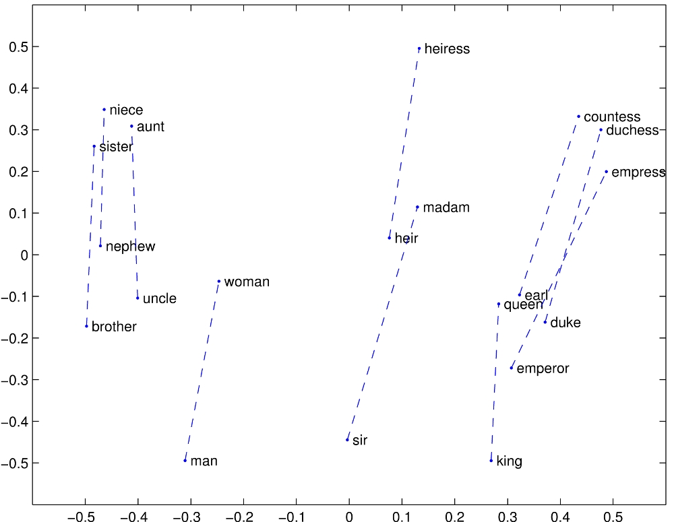
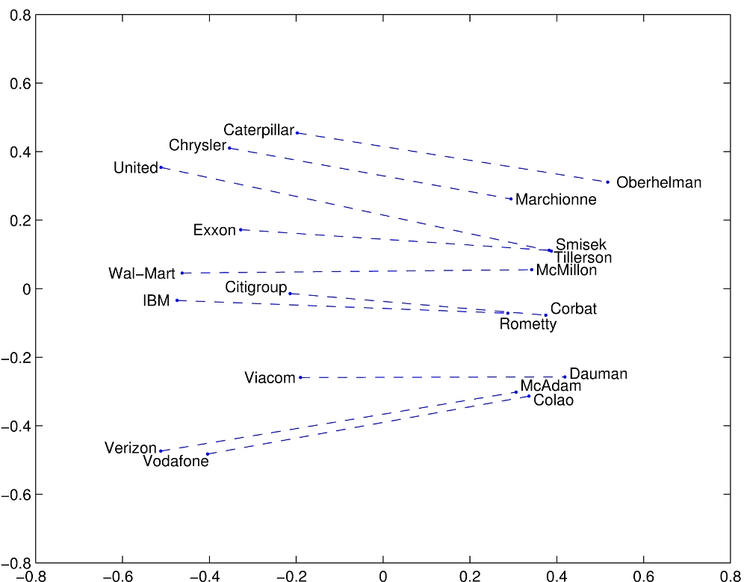
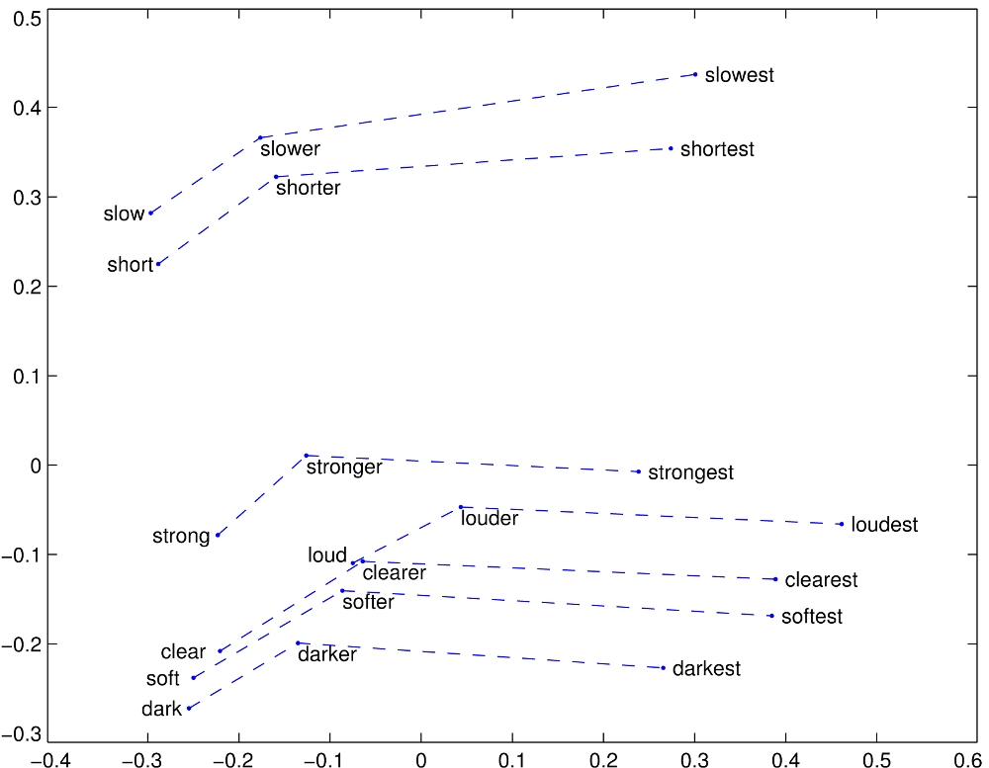
Word Embeddings
What kind of semantic information do they encode?
Gender
Company - CEO
Adjective - Comparative - Superlative
https://nlp.stanford.edu/projects/glove/ (glove.840B.300d.zip)

Slide 54
Word Embeddings
How are they trained?
By exploiting the "Distributional Hypothesis", i.e., "Words with similar distributions have similar meanings" [1]
In other words: "Words appearing in similar contexts will tend to have similar meanings"
Neural Methods
word2vec [2]
Continuous bag of words: Predict a word given its context
Skip-gram: Predict the context of a given word
FastText [3]: Like Skip-gram but with access to subword structures
Co-occurrence statistics
GloVe [4]: Least squares model trained on global word-word co-occurrence counts.
[1] Distributional Structure (Harris 1953)
[2] Efficient Estimation of Word Representations in Vector Space (Mikolov et al., 2013)
[3] Enriching Word Vectors with Subword Information (Bojanowski et al., 2017)
[4] Glove: Global Vectors for Word Representation (Pennington et al., 2014)

Slide 55
Closing words

Slide 56
Closing words
Current NLP approaches rely on Recurrent Neural Networks for modeling interactions between words within a sentence.
These RNNs take our Word-level vector representation of the sentence, and return another word-level representation of the same sentence (= with the same number of dimensions)
the
0
0.3
0.4
0.2
0.2
0.4
dog
6
0.2
0.1
0.6
0.7
0.4
sat
2
0
0.4
0.7
0.2
0.4
on
3
0.4
0.8
0.2
0.5
0.8
the
0
0
0.6
0.2
0.2
0
cold
7
0
0.5
0
0.0
0.2
floor
8
0
0.8
0
0
0.5
.
5
0
0.3
0
0.4
0

Slide 57
Contextualized word representations
The new trend is to use pre-trained Language Models instead of word embeddings:
ELMo
ULMFiT
BERT
Benefits:
Better performance
Downsides:
Code-dependent (an implementation in TensorFlow will not work in PyTorch and vice-versa)
More steps required to make them work

Slide 58
Closing words
Next talk by Suzana:
Seq2seq
Afternoon workshop by Asir:
Hands-on

Slide 59
Closing words
Feel free to reach out
https://twitter.com/jabalazst
https://www.linkedin.com/in/jorgebalazs/
https://github.com/jabalazs
jorge@weblab.t.u-tokyo.ac.jp

Slide 60
Thank you!

Slide 61
QA

Slide 62
Going deeper
Blogs
Natural Language Processing is Fun! [ part 1 | part 2 ]
Canning the can’t — fun with homonyms and word vectors [blog]
The Unreasonable Effectiveness of Recurrent Neural Networks [blog]
Word embeddings in 2017: Trends and future directions [blog]
Podcasts
NLP Highlights [soundcloud]
Lex Friedman’s “AI” [link]
Videos
Sentdex NLP tutorial [playlist] (He has lots of accessible tutorials on lots of topics)
Books
Speech and Language Processing [pdf]
An Introduction to Information Retrieval [homepage | pdf]
Pattern Recognition and Machine Learning [pdf]
Papers
Natural Language Processing (Almost) From Scratch [pdf]
Computational Linguistics and Deep Learning [pdf]
Miscellaneous
https://github.com/keon/awesome-nlp

Slide 63
Going deeper
People
Me! (Jorge Balazs) [@jabalazst | website]
Christopher Manning @chrmanning
Abigail See @abigail_e_see
David Ha @hardmaru
Dan Jurafsky @jurafsky
Sebastian Ruder @seb_ruder
Stephen Merity @Smerity
Samuel Bowman @sleepinyourhat
Kyunghyun Cho @kchonyc
Emily Bender @emilymbender
François Chollet @fchollet
Hal Daumé @haldaume3
Richard Socher @RichardSocher
Vered Shwartz @VeredShwartz
Jason Eisner @adveisner
Manaal Faruqui @manaalfar
Thang Luong @lmthang
Tal Linzen @tallinzen
Omer Levy @omerlevy_
Chelsea Finn @chelseabfinn
Isabelle Augenstein @IAugenstein
Yoav Goldberg @yoavgo
Noah Smith @nlpnoah
Barbara Plank @barabara_plank
Ryan Cotterell @_shrdlu_
Graham Neubig @gneubig
Jane Wang @janexwang
Christopher Olah @ch402
Andrej Karpathy @karpathy
Hugo Larochelle @hugo_larochelle
Ian Goodfellow @goodfellow_ian
Rico Sennrich @RicoSennrich
Mirella Lapata [website]
If you’re too lazy to follow them all, just follow me! :D
I’ll retweet and share what I think is relevant

